Slide 1
The mathematical model used/Progress so far. P4P:58

Slide 2
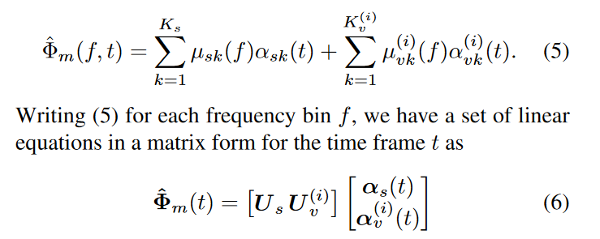
GMM BASED MULTI-STAGE WIENER FILTERING FOR LOW SNR SPEECH ENHANCEMENT
Proposes a vector projection model of Ax=b.
For each row of the A matrix, the means of a univariate GMM populate the columns.
The number of columns are determined by the number of components of the GMM and the number of rows are the number of frequency bins.

Slide 3
Interpretations
There are two ways to interpret the proposed model in the literature.
1st is that it it is modeled as an overdetermined set of equations.
2nd is that for each row of means there are different a_vk applied to each mean.
For the first case, the overdetermined system of equations models the system as: Ax=b
A = |A B C| b = |p| x = [a,b,c,d…]
|D E F| |q|
|G H I| |r|
|J K L|

Slide 4
Over-determined
Systems of equations
This model minimizes the least squares error by finding the best x that will result in the best transformation of A such that the resulting estimate is as close to the values of b.
The pseudo-inverse of A is taken and multiplied to b to find the best x.
The pseudo-inverse is a generalized inverse of a matrix, where non-square matrices can be approximately inverted by decomposing the A matrix as a series of invertible matrices.
These matrices consist of three matrices that are called the singular values.
When these matrices are all multiplied, the resulting transformation will result in the A matrix.

Slide 5
Continuing on.
Given that A is composed of a predefined vector determined by the GMM means, x (or a_vk in the paper) can be determined by taking the pseudo inverse of A and multiplying this with the PSD of the current frame.
A and x can then be multiplied to find the underlying noise PSD of the mixture.
In theory, this will result in an estimate that will have the least squares error.
In practice and application to this speech enhancement project, we find that the choice of the A matrix is very important otherwise, the resulting estimate will be bad and inconsistent.

Slide 6
The 2nd interpretation
If the authors imply that for each row of the mean vector, there are different a_vk (power-coefficients) then the new model is as follows.
The pseudo inverse of the mean vector (A) is taken (A^+) and pointwise multiplied by the PSD of the mixture to derive the power-coefficients to be applied to each row/GMM of the mean vector A.
This is very unusual.
This model is basically adjusting the mean values per row such that the sum of each row is close as possible to the PSD value of that frequency bin.
This takes the form of A dot (bA^+)^T
The vector b is pointwise multiplied by the pseudo-inverse vector A^+ and transposed before being multiplied to A.

Slide 7
Results
These two interpretations were then implemented.
Implementation consists of both the traditional model (GMM only) and the use of GANs.
For both interpretations, the GAN attempts to generate a ‘perfect’ A matrix such that both the implemented mathematical operations will result in the best estimate of the noise PSD.
On evaluation, the GAN implementation of the overdetermined systems resulted in very bad estimates which resulted in distorted/un-denoised outputs.
To be expected as overdetermined systems usually only have least squares solutions. There are no solutions which can solve for this.

Slide 8
Results pt.2
It was found that the following model performed better than that the overdetermined systems.
A (bA^+)^T.
We do not have any idea why the following model works. For the given model, I cannot think of any physical interpretations but clearly there is a relationship between the Mixture PSD (b) and the observation/mean vectors(A).
However this is a proof of concept that shows that for a Given A vector, with each row having different a_vk applied to each element, the accurate estimation of noise is possible.

Slide 9
Thoughts so far?
In essence, we have found that modifying the A matrix for overdetermined systems using a GAN to act like an autoregressive model does not work. It cannot find the perfect A such that the solution is accurate in the least squares sense and results in the most accurate estimate of the noise PSD from the mixture.
The 2nd interpretation works nicely with the developed GAN, but we cannot figure out why this works.

Slide 10
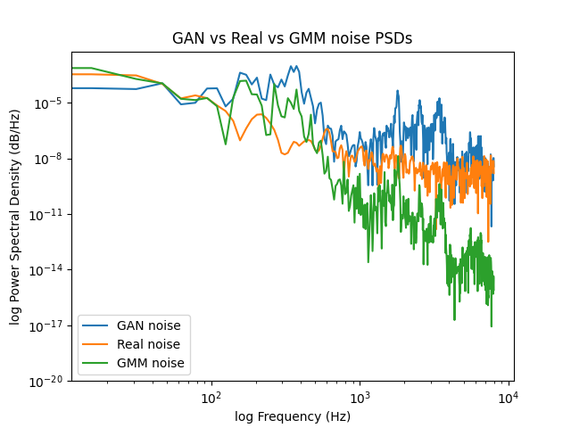
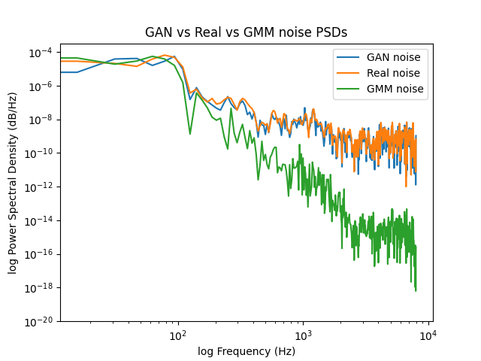
Model evaluation
When tested with training data, filtering performance is nearly the same as having optimal wiener filter coefficients.
Interestingly, when the GAN fails, the resulting distribution of both the GAN and GMM is similar as seen from above.

Slide 11
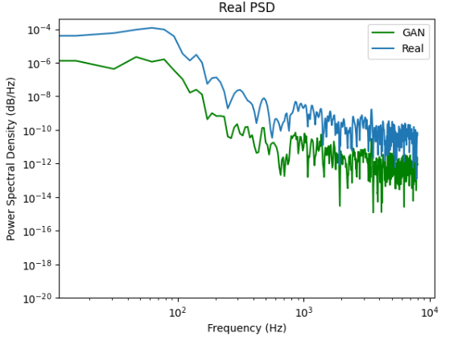
Continuing on
The naive assumption we have taken is that a better estimate of noise PSD will result in a better estimate of speech through even though the estimated speech is sub-optimal.
We find that even though if the noise PSD were to be completely known, the sub-optimal estimation of speech still results in performance as if both speech and noise were sub-optimal (GMM only implementation).
Interestingly, the GAN can find the correct distribution at lower PSD estimates. It completely fails to find a solution at the right magnitudes.

Slide 12
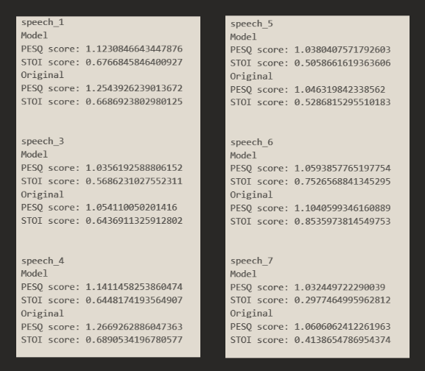
Combining the GAN with the classifier to determine the noise suppression
For testing the GAN an alpha value is used to determine the aggressiveness of the noise suppression when performing spectral subtraction
Changing this value at each iteration when the SNR doesn’t decrease until 0dB is reached
The alpha controls the strength of the spectral masking applied during noise reduction.
Close to 0 means very little noise reduction
Greater than 1 means the spectral mask becomes smaller and causes more aggressive noise reduction.
From listening to the audio the bass of the audio has decreased and resulted in what sounds like lowers SNR as what is classified by the classifier.
But according to the evaluation data both the PESQ and STOI information give slightly worst scores than the original file. And in some cases slightly higher.

